Slide 1
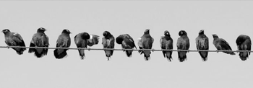
From silos to synergy: Creating vibrant SoTL networks using the NEXUS framework
The power of Togetherness
Professor Earle Abrahamson e.abrahamson@herts.ac.uk

Slide 2
Disclaimer
In the empowering words of Amanda Gormen
This presentation/research, like her inaugural address at President Biden’s inauguration, is…
far from pristine but that doesn’t mean we/it are/is striving to form a union that is perfect We are striving to forge a union/network with purpose

Slide 3
Community, Compassion, CULTURE, CURIOSITY, COMMITMENT, COURAGE, CONNECTION, COLLABORATION
I - EYE
Add another word that defines the value or threat of building and sustaining networks

Slide 4
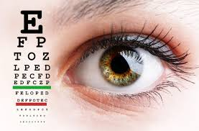
The SOTL I-EYE TEST
Is your learning and teaching vision clearer with or without
Partnerships
Collaborators
Context
Connections
Institutional Direction
International Networks
When does your vision blur ?
What lens enables success? What lens leads to isolation?

Slide 5
Agenda
Setting the Scene for SoTL
The problem with Isolation
Building Community
The Nexus Framework
Back to the Future

Slide 6
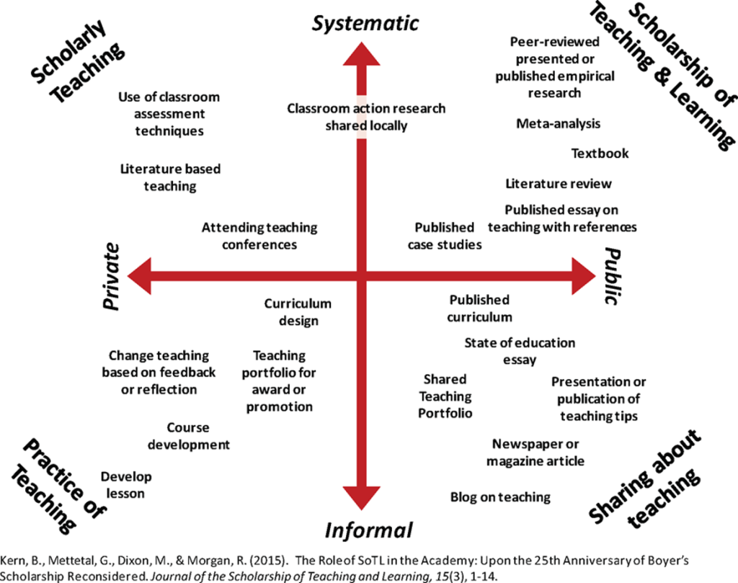

Slide 7
Felten (2013)
All well and good but what makes GREAT SoTL – Academic Rigor – Hamilton (24)

Slide 8
Grand Challenges for SoTL – Scharff et al 2023
Creativity and Criticality
Deep Learning
Complexities of Learning
Identities
Promotion and Growth

Slide 9
SOTL GRAND CHALLENGE 5 Promotion, Growth and Practice of SoTL
Epistemologies - epistemicide
Nurturing Networks – establishing relationships by designing partnerships
Skills for the 21st century in the era of AI – What is humanly possible? – learning to rewire humanity so we talk to one another.

Slide 10
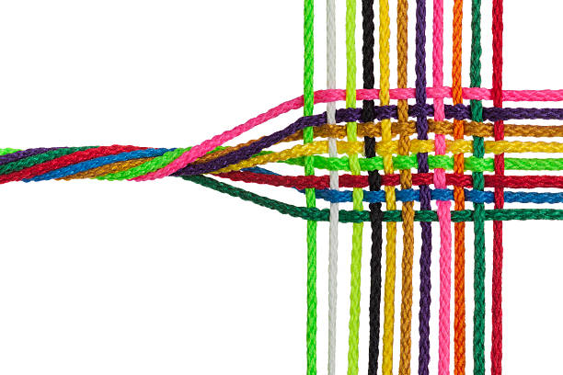
TWISTED TO TAPESTRY
TWISTED TO TAPESTRY

Slide 11
Building bridges
The challenges of isolation within academic communities
The fragmented nature of SoTL research and practice
The need for stronger, more interconnected networks
Not merely forming but performing and driving ideas and actions forward…..

Slide 12
Introducing the Nexus Framework
Connecting, People, Places and Purpose

Slide 13
International
NEXUS: A structured framework for understanding SoTL network development
The three key components: individual, institutional, and international dimensions
Institutional
Individual

Slide 14
SoTL Taxonomy Hutchings and Shulman 1999
What is?
What works?
What could be?
What new theories may emerge?

Slide 15
Identifying and nurturing individual scholars' motivations
Developing essential skills for network participation
Fostering a culture of collaboration and support
Key questions
Inward facing
Why should I join a network
What value would joining a network add?
How would a network contribute to my scholarly inquiry?
Outward facing
What value would I bring to the network
What could I contribute
What connections could I bring to a network
What would a successful contribution to a network look like?
Individual

Slide 16
International
Creating enabling environments for SoTL
Implementing supportive policies and procedures
Providing adequate resources and infrastructure
Institutional
Institutional
Individual

Slide 17
Building cross-border partnerships and networks
Facilitating knowledge exchange and innovation
Addressing barriers to international collaboration
International
Institutional
Individual

Slide 18
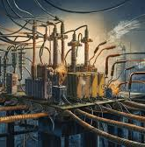
Power Drain Power drive

Slide 19
Use your own practice or context to consider the question.
Creating enabling environments for SoTL
Implementing supportive policies and procedures
Providing adequate resources and infrastructure

Slide 20
Emphasise the importance of sustainable SoTL networks
Encourage participants to become active contributors and leaders
Outline potential future directions and research areas
How does your work or interest, do this?
Is there a place for AI in SoTL network design?

Slide 21
From A Network To Your Net Worth – Making Things Happen Responsibly And Inclusively The Focus Of A Network Is Not Necessarily On Providing Answers But Through Design, Generating Different Questions. Think About The Value, The Impact, The Reach, The Sustainability Of Networks. How Can They Be Valuable With You? How Can They Be Valuable To You? Who gets to attend? Human and/or Machine????

Slide 23
From silos to synergy: Creating vibrant SoTL networks using the NEXUS framework
The power of Togetherness
Professor Earle Abrahamson e.abrahamson@herts.ac.uk

