Slide 1
Working in Partnership with Students
Enhancing Learner Experience
Nick Weise PFHEA
Department of Chemistry / Division of Medical Education
Inaugural and Honorary Fellow (Institute of Teaching & Learning)
Teaching & Learning Enhancement Lead (Department of Chemistry)
Faculty Lead for Student Experience & Inclusion (Biology, Medicine & Health)

Slide 2
“Peer Support offers you the opportunity to gain support, advice and help with your studies from students who have been in the same position as you. These students are able to share their experience. They volunteer to provide a safe space where you can ask questions at any time throughout your year.”
Peer-assisted Study Sessions (PASS) Peer Mentoring (PM) Sessions

Slide 3
Industrial Placement Support
Interdisciplinary Mentoring
4th years returning from year-long industrial experience are invited to mentor 2nd years applying.
This year, those interested in summer students were included as well (~80 students).
Chemistry Placement Mentoring model expanded to other departments – e.g. Mathematics, Materials Science.
Scope for further expansion across further departments in Natural Sciences and Engineering.

Slide 4
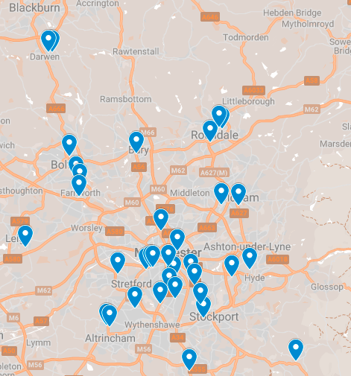
37 Commuter Peer Mentors
Supporting First Years Locally
(January 2021)
Commuter Peer Mentoring “You are not alone”
Halls, student houses and flat shares present the opportunity of a local university peer group
Commuter Students face a larger barrier to similar opportunities => lower that barrier by bringing commuter students from the same area together in peer mentor groups
Additional social/cultural capital (access to knowledge about UoM) and psychosocial aspects of identity concerning transition to university.

Slide 5
Commuter Peer Mentoring 2023/24
~1000 First and Foundation Year Students
29 Commuter Peer Mentors
3 Student Coordinators:
Muskan Longani - Coordinator for the Manchester & City Region
Kim Godinho - Coordinator for the Lancashire & West Yorkshire Region
Antasar Bashir-Suleman - Coordinator for the Merseyside & North Midlands Region

Slide 6
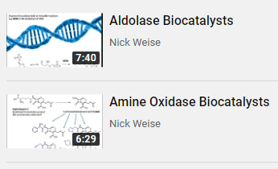
Flipped Teaching Environment
CHEM20711 Unit (Videos + Feedback Classes)
What is the best use of the students’ own time?
What is the best use of the time I have with the students?
i.e. how to partition these activities:
Passive Learning student’s own time
Reviewing Material both / either
Active Learning my time with the students
Who is the best placed person to do things?
i.e. who should input on:
Intended Learning Outcomes Lecturer (trained in T&L, subject ‘expert’)
Lecture Content Lecturer (trained in T&L, subject ‘expert’)
Formative / Practice Questions PASS Leaders (trained in T&L, have experienced the unit)
Assessments Lecturer (trained in T&L, subject ‘expert’)

Slide 7
Working with Students
Where else can we do this?
‘Experts by Experience’
Professional Services
UEQ Participants
PASS Leaders
ResLife Advisors
Peer Mentors
(Graduate) Teaching Assistants
Course / SSLC Representatives
Academics
Other Students
Trained TLSE Practitioners
(Synchronous) Material Reviews:
CHEM10022 (2018/19)
CHEM10111 (since 2019/20)
CHEM20711 (since 2019/20)
CHEM Online Practicals (2020/21)
CHEM Unit Peer Dialogue Trial (2021/22)
Other Departments / Faculty?
Delivery/Provision Consultations:
PASS Leader Survey for Online Transition (2020)
PASS Leader Module Design Workshop (2021)
Staff Training/Development in T&L
Teaching for Researchers (TfR): FSESS7003
New Academics Programme (NAP): FSE60001

Slide 8
Student Voices in the Curriculum
What might a ‘mini-MOOC’ project look like?
A Literature Review is a hallmark of project work
In this project it is used to explore the underlying pedagogy of e-learning (an unfamiliar topic)
Students then bring their own interests and subject / degree knowledge into their submodule
So do the students need to be from the same discipline / department / faculty?
Student A – Submodule 1
Video(s) linked to ILOs
Aligned Assessments
Extra Reading Material(s)
Student B – Submodule 2
Video(s) linked to ILOs
Aligned Assessments
Extra Reading Material(s)
Student C – Submodule 3
Video(s) linked to ILOs
Aligned Assessments
Extra Reading Material(s)
Student D – Submodule 4
Video(s) linked to ILOs
Aligned Assessments
Extra Reading Material(s)
Coherent Online Course the Integrates Student Voice into the Curriculum

Slide 9
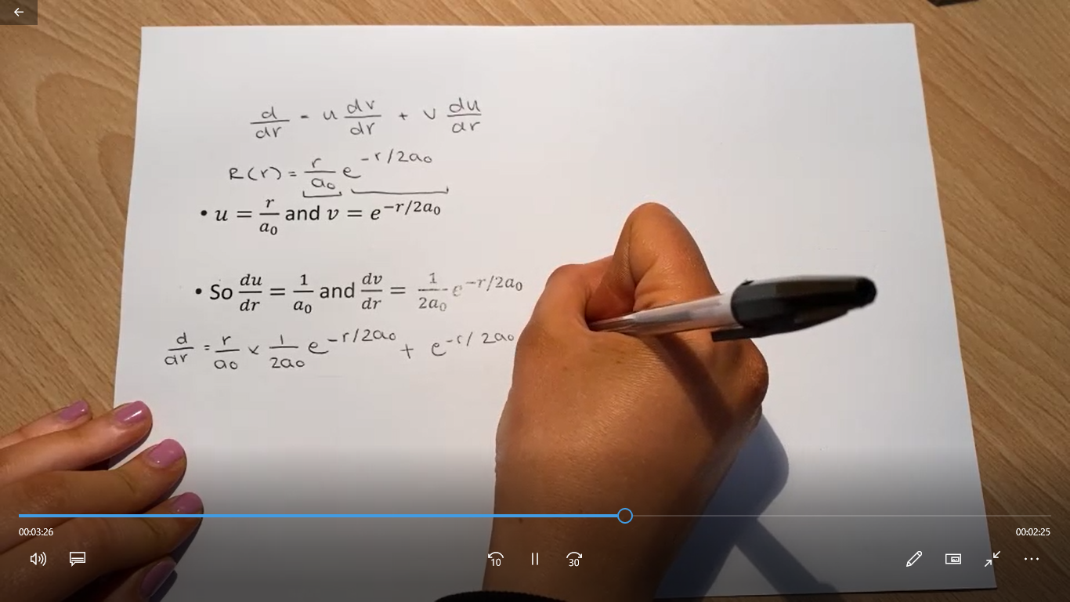
Example Content
From Last Year!
Can you guess which were made by Chemists and which by Mathematicians?

Slide 10
Student Voices in the Curriculum
Current and future plans
We hope to expand to include students from other departments in future:
Chemistry
Mathematics
Mechanical, Civil and Aerospace Engineering
Computer Science
Earth & Environmental Sciences
Biological Sciences
Further exploration of student voice integration for inclusive curricula
Possibility for ‘public engagement with research’ projects?
Would directed or strategically-aligned projects be better?
(at the moment students make a course about whatever they want)

Slide 11
How do you work in partnership with students? How would you like to work in partnership with them?

Slide 12
Reward and Recognition
What can we offer our student partners?
Pre-existing Mechanisms
PASS Leaders: ‘Step Up and Lead’ role / Higher Education Achievement Record
Project Students: 24 of 40 credits of CHEM30620 for their degree
Additional Opportunities:
PASS Coordinators in some schemes give points / prizes for extra work
Associate Fellowship of the Higher Education Academy (Advance HE Accreditation)
AFHEA Criteria (UK Professional Standards Framework in Higher Education 2011)
Two areas of activity: A1 (design / plan learning activities), A5 (undergo and apply professional development)
Core knowledge K1 (subject/discipline knowledge) and K2 (knowledge of appropriate pedagogic approaches)
Any number of professional values V1-4 (including none)

Slide 13
Leadership in Education Awards Programme
For Applicants from The University of Manchester
This programme supports anyone working or studying at the University of Manchester in documenting and evidencing how they contribute to learning and the student experience.
It is an opportunity for you to receive a formal, national qualification.
We have no limit on the number of awards given – if you properly evidence your practice against the criteria, we can recommend you for the award.
Once awarded Associate Fellowship, you’ll get to put the letters AFHEA after your name for the rest of your life to show that you have been accredited by a professional body for the quality of your contribution to education!
All you need to do is show how what you have already done (teaching, supporting learning, enhancing the student experience, etc.) maps against the Professional Standards Framework for Higher Education in the UK

Slide 14
Widening Access to Advance HE Accreditation
Including Students in Our T&L Culture
Pioneering a Student Leadership in Education Awards Programme Cohort
Advance HE Accreditation at the University of Manchester is supported by an accredited internal programme
Originally this was only open to staff within the institution (and some postgraduate researchers)
However, the university has many student leaders who contribute immensely to Teaching, Learning and the Student Experience:
Peer Mentors
Peer-assisted Study Session Leaders
Peer Support Coordinators
Residential Life Advisors
Student Partner Interns
Educational Project Students
...
A bespoke support package was set up to enable students to achieve professional recognition commensurate with their contribution.
This was to allow equity of provision, shared ownership of university goals and motivate students through reward / recognition.
Notes:
Vision = culture of inclusive enhancement collaborative academic enhancement upskilling & valuing (no matter your position / background)
student voice & partnership have become strategic drivers within the university

Slide 15
Widening Access to Advance HE Accreditation
Bespoke Support Pipeline
Recruitment of Candidates (Peer Support Returners)
Peer Mentoring Groups for Candidates
Student / Alumni as Assessors
Institutional Panel
(winter and summer)
Coaching Workshop
(bespoke to Peer Support / UGs)
Student / Alumni Mentor (from our programme)
Lead Assessment and Senior Mentorship
Over 330 undergraduates and recent graduates awarded AFHEA since 2018/19
48 of those in the 2020/21 academic year with 7 awardees going onto become cohort 2 assessors
Participant case studies act as repository of best practice in student-led activity, partnership and co-creation.
Students now make up the majority of institutional AFHEA awardees (empowered / given tools and networks)
Notes:
TEF database and submission– a repository of student co-created solutions = value student voice driving positive change across the university

Slide 16
Widening Access to Advance HE Accreditation
Feedback from Students
“The LEAP process has been invaluable for me as someone who is quite young in the Higher Education sector. I was very fortunate to have achieved my AFHEA in the final-year of my BSc... this has helped me move around more fluidly in my time in Higher Education and have more of an impact when working with academic staff across the University of Manchester.”
"Receiving this Associate Fellowship from the Higher Education Academy through the LEAP programme has been one of my greatest personal achievements this year. ... I have learned so much about myself, how to reflect on my actions, and how to organise a large peer support team through my positions …"
“I found the process of being a mentor and assessor to be much more impactful than when I applied for AFHEA myself. Helping others understand how their roles meet the UKPSF helped me understand my own roles much more than before.”
“Just wanted to say a big thank you for all the help with the teaching project and applications. Just thought I’d let you know that I got a 2:1 overall thanks to a good mark in my Labs and that I was awarded the AFHEA. On top of that I just got offered the RSC teaching scholarship I applied for so a huge thank you for all your help with that application, I start my PGCE in September.”
Notes:
strategic approach that empowers and develops students give back – community & belonging they are higher education professionals
learner ownership of achievement = can drive forward with confidence scalable / sustainable cycle of enhancement

Slide 17
New Associate Fellowship Criteria (as of 2023)
At least K1, K2, K3, any two As, V1 and V3
V1 respect individual learners and diverse groups of learners
V2 promote engagement in learning and equity of opportunity for all to reach their potential
V3 use scholarship, or research, or professional learning, or other evidence-informed approaches as a basis for effective practice
V4 respond to the wider context in which higher education operates, recognising implications for practice
V5 collaborate with others to enhance practice
K1 how learners learn, generally and within specific subjects
K2 approaches to teaching and/or supporting learning, appropriate for subjects and level of study
K3 critical evaluation as a basis for effective practice
K4 appropriate use of digital and/or other technologies, and resources for learning
K5 requirements for quality assurance and enhancement, and their implications for practice
A1 design and plan learning activities and/or programmes
A2 teach and/or support learning through appropriate approaches and environments
A3 assess and give feedback for learning
A4 support and guide learners
A5 enhance practice through own continuing professional development
Notes:
Vision = culture of inclusive enhancement collaborative academic enhancement upskilling & valuing (no matter your position / background)
student voice & partnership have become strategic drivers within the university

Slide 18
How do you reward and recognise student partners? What do you wish you could do?

Slide 19
Working in Partnership with Students
Enhancing Learner Experience
Nick Weise PFHEA
Department of Chemistry / Division of Medical Education
Inaugural and Honorary Fellow (Institute of Teaching & Learning)
Teaching & Learning Enhancement Lead (Department of Chemistry)
Faculty Lead for Student Experience & Inclusion (Biology, Medicine & Health)

Slide 20
Acknowledgements
AFHEA Assessors
Dr. Mauro Rinaldi SFHEA
Dr. Rebecca Ruscoe FHEA
David Ruiz-Izuriaga SFHEA
Dr. Christos Hadjiarapis FHEA
MATH30000 Students
Seif Ashour
Chuying Jiang
Rezwan Kabir
Michael Adoasi
MATH30000 Counterpart Supervisor
Prof. Louise Walker PFHEA
CHEM30620 Students
Samuel Lincoln
Mehrin Sadia
Yijing Zhang
Beatriz Da Costa Honrado
Jordan Pacho AFHEA
Nathan O’Grady AFHEA
Tanish Dadlani
Henry Olsen
Summer Anani
Alisha Ayyaz
Yichen Huang
Shuqi An
Catherine Clayton AFHEA
Sean Seang Lee AFHEA

